Slide 1
Computing in English schools:
Lessons to learn for AI education
Miles Berry
University of Roehampton
@mberry
9 November 2019
These slides: bit.ly/aaai19slides

Slide 2

A basic understanding
In the near future, perhaps sooner than we think, virtually everyone will need a basic understanding of the technologies that underpin machine learning and artificial intelligence.
ACM Europe / Informatics Europe
Notes:
In the near future, perhaps sooner than we think, virtually everyone will need a basic understanding of the technologies that underpin machine learning and artificial intelligence.

Slide 3
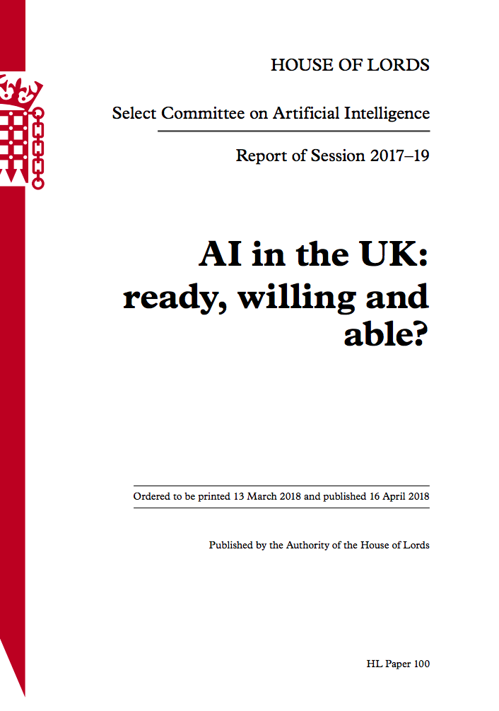
For some, or for all?
Children need to be adequately prepared for working with, and using, AI. For a proportion, this will mean a thorough education in AI-related subjects, requiring adequate resourcing of the computing curriculum and support for teachers. For all children, the basic knowledge and understanding necessary to navigate an AI driven world will be essential. In particular, we recommend that the ethical design and use of technology becomes an integral part of the curriculum.
Notes:
Children need to be adequately prepared for working with, and using, AI. For a proportion, this will mean a thorough education in AI-related subjects, requiring adequate resourcing of the computing curriculum and support for teachers. For all children, the basic knowledge and understanding necessary to navigate an AI driven world will be essential. In particular, we recommend that the ethical design and use of technology becomes an integral part of the curriculum.

Slide 4
Curriculum coherence
Notes:
Four years on -
what has England learnt?

Slide 5

Curriculum Coherence
The term ‘coherence’ is a highly precise technical term: a national curriculum should have content arranged in an order which is securely based in evidence associated with age-related progression, and all elements of the system (content, assessment, pedagogy, teacher training, teaching materials, incentives and drivers etc) should all line up and act in a concerted way to deliver public goods
The term ‘coherence’ is a highly precise technical term: a national curriculum should have content arranged in an order which is securely based in evidence associated with age-related progression, and all elements of the system (content, assessment, pedagogy, teacher training, teaching materials, incentives and drivers etc) should all line up and act in a concerted way to deliver public goods
Oates, 2010

Slide 6

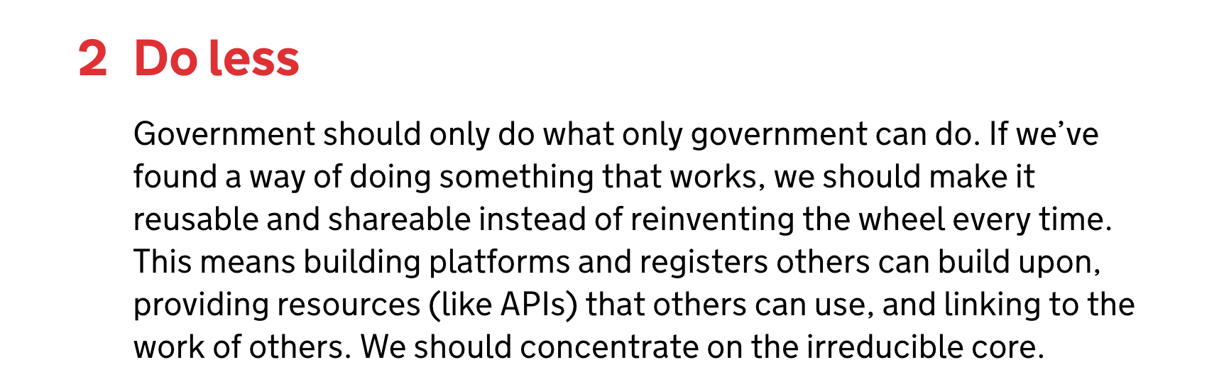

Slide 7
Content

Slide 8

What is the curriculum for?
Education Act, 2002

Slide 9

Beauty or utility?
If you want a golden rule that will fit everybody, this is it:
Have nothing in your houses that you do not know to be useful, or believe to be beautiful.
Morris, 1880

Slide 10
AI in the English computing curriculum?
Aims: can evaluate and apply information technology, including new or unfamiliar technologies, analytically to solve problems
5-7: recognise common uses of information technology beyond school
7-11: use and combine a variety of software (including internet services) to create, systems and content that accomplish given goals, including analysing and evaluating data and information
11-14: undertake creative projects that involve using, and combining multiple applications, to achieve challenging goals, including analysing data
14-16: develop and apply their analytic, problem-solving, design, and computational thinking skills
16-18 (AQA): project suggestions include an application of artificial intelligence; investigating an area of data science using, for example, Twitter feed data or online public data sets; and investigating machine learning algorithms.
Notes:
Aims: can evaluate and apply information technology, including new or unfamiliar technologies, analytically to solve problems
5-7: recognise common uses of information technology beyond school
7-11: use and combine a variety of software (including internet services) to create, systems and content that accomplish given goals, including analysing and evaluating data and information
11-14: undertake creative projects that involve using, and combining multiple applications, to achieve challenging goals, including analysing data
14-16: develop and apply their analytic, problem-solving, design, and computational thinking skills
16-18 (AQA): project suggestions include an application of artificial intelligence; investigating an area of data science using, for example, Twitter feed data or online public data sets; and investigating machine learning algorithms.

Slide 11
Foundations
Computer Science
Applications
Information Technology
Implications
Digital Literacy
Notes:
The three elements of the new computing curriculum. The question ‘how does Google work?’ can be answered in relation to all three of these.

Slide 12
Foundations
Artificial Intelligence
Applications
Machine Learning
Implications
Ethics
Notes:
The three elements of the new computing curriculum. The question ‘how does Google work?’ can be answered in relation to all three of these.

Slide 13
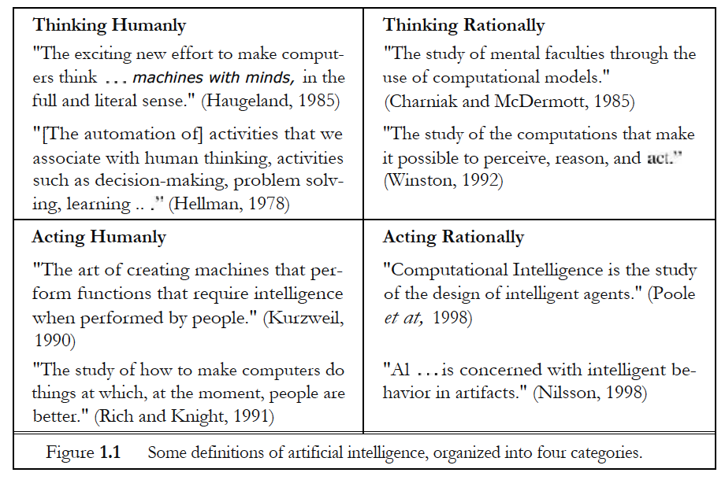
Foundations
Russell and Norvig, 2010

Slide 14
Foundations
Input
Program
Output

Slide 15
Foundations
Training data
ML Algorithm
Input
Model
Output

Slide 16



Applications

Slide 17
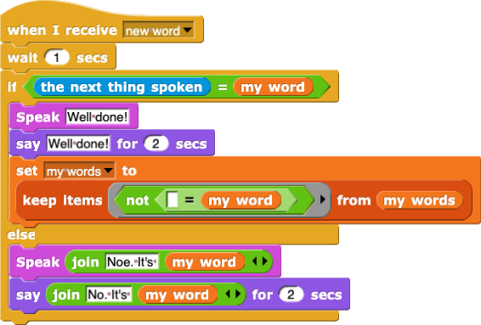
Applications

Slide 18
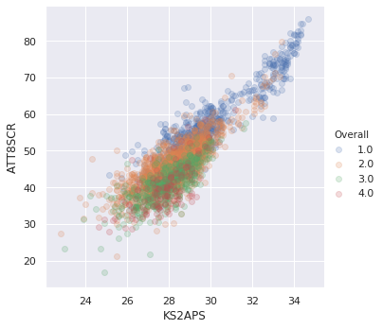
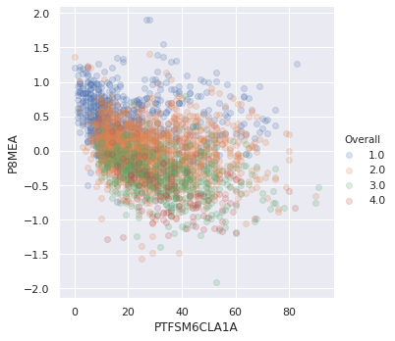
Applications
qv Harford, 2018

Slide 19
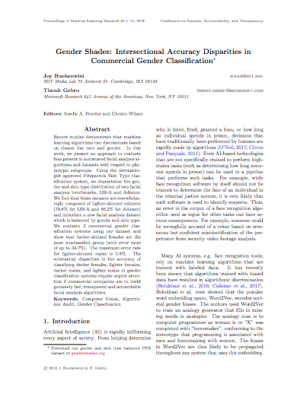
Implications
Using the dermatologist approved Fitzpatrick Skin Type classification system, we characterize the gender and skin type distribution of two facial analysis benchmarks, IJB-A and Adience.
We find that these datasets are overwhelmingly composed of lighter-skinned subjects (79.6% for IJB-A and 86.2% for Adience) and introduce a new facial analysis dataset which is balanced by gender and skin type.
We evaluate 3 commercial gender classification systems using our dataset and show that darker-skinned females are the most misclassified group (with error rates of up to 34.7%). The maximum error rate for lighter-skinned males is 0.8%.
Bulamwini and Gebru, 2018

Slide 20
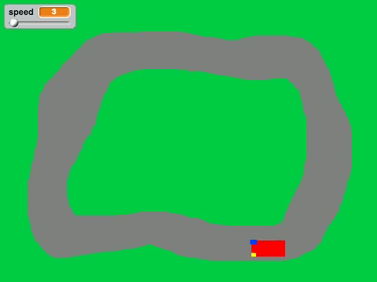
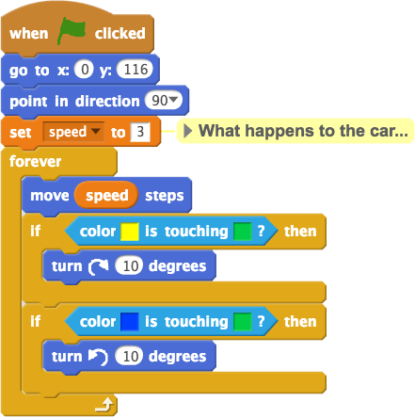

Slide 21
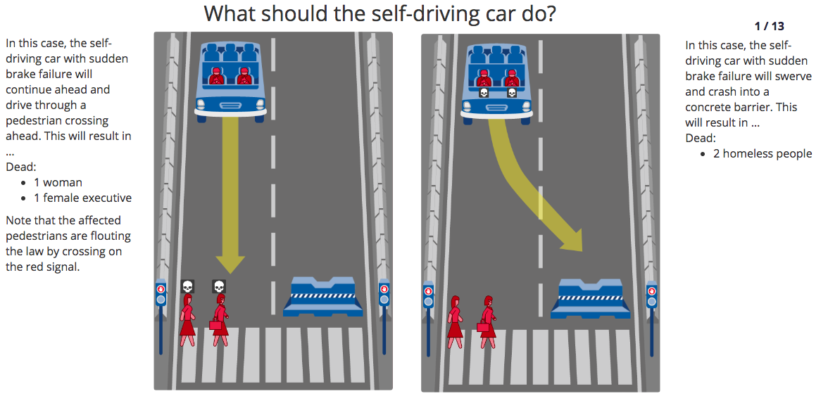
moralmachine.mit.edu

Slide 22
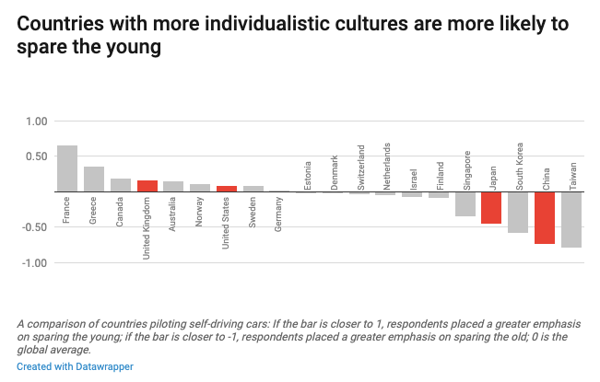
Hao, 2018

Slide 23
Assessment

Slide 24
capability = knowledge + application

Slide 25


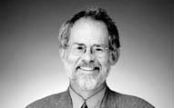
Projects and questions
Neither multiplechoice questions nor open-ended projects alone tell the whole story of student understanding. It would be unwise to ignore learner agency, motivation, creative expression and design thinking that students bring to projects of their own choosing. This is especially critical when one of the stated goals of introducing CS is to inspire children to pursue this discipline and broaden the CS pipeline. However, it would be equally imprudent to not include objective measures that can be scaled and assess students’ understanding of core computational concepts as well as associated skills such as debugging and code-tracing.
Grover, Cooper and Pea, 2014

Slide 26

Test questions
The Commission recommends the establishment of a national item bank of assessment questions to be used both for formative assessment in the classroom, to help teachers evaluate understanding of a topic or concept, and for summative assessment, by enabling teachers to create bespoke tests for assessment at the end of a topic or teaching period.
McIntosh et al 2015

Slide 27
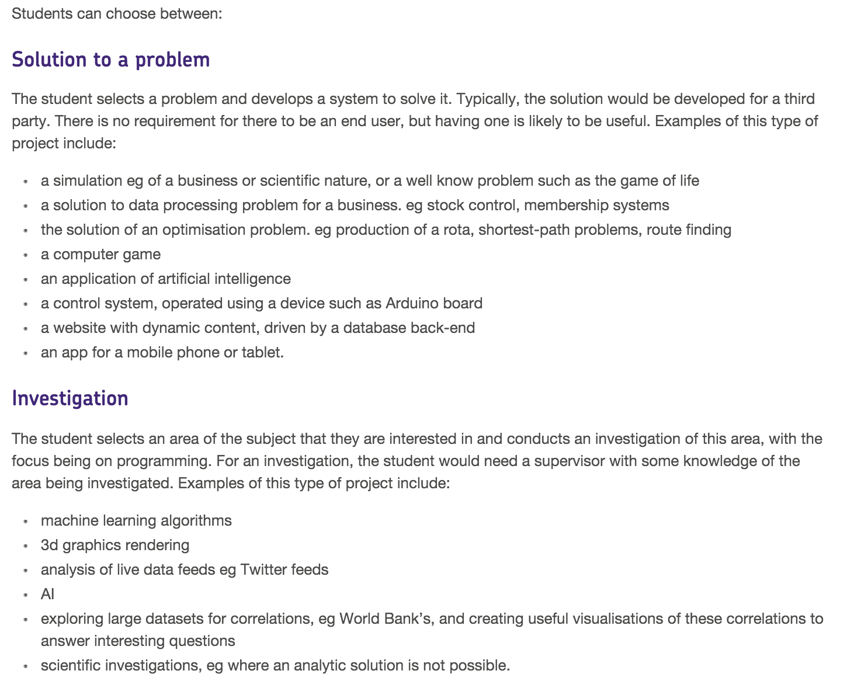
AQA, 2015

Slide 28
Pedagogy

Slide 29
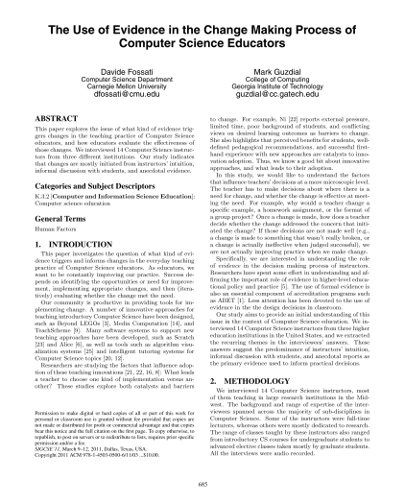
The pragmatic teacher?
Computer Science instructors rely mostly on intuition and anecdotal evidence to make decisions about changes in their daily teaching practice… instructors used little empirical data for deciding to make a change, and for deciding whether a change was successful or a failure.
Fossati and Guzdial, 2011

Slide 30
What we’re learning about teaching computing
It’s not about the code - think before you click
You don’t have to use a computer
It’s easier to read code than to write code
It’s easier to edit code that to start from a blank screen
Making things matters
Pair programming is powerful
Debugging helps grow mindsets
Go for depth not breadth
Look for interesting contexts
This is for everyone

Slide 31
Teacher training

Slide 32

Teaching matters
The quality of an education system cannot exceed the quality of its teachers
Interview South Korea 2007, cited in Barber and Mourshed 2007

Slide 33
Outstanding AI teaching?
Pedagogy
Outstanding teaching of AI
CS knowledge
AI knowledge
+
=
IT skills

Slide 34
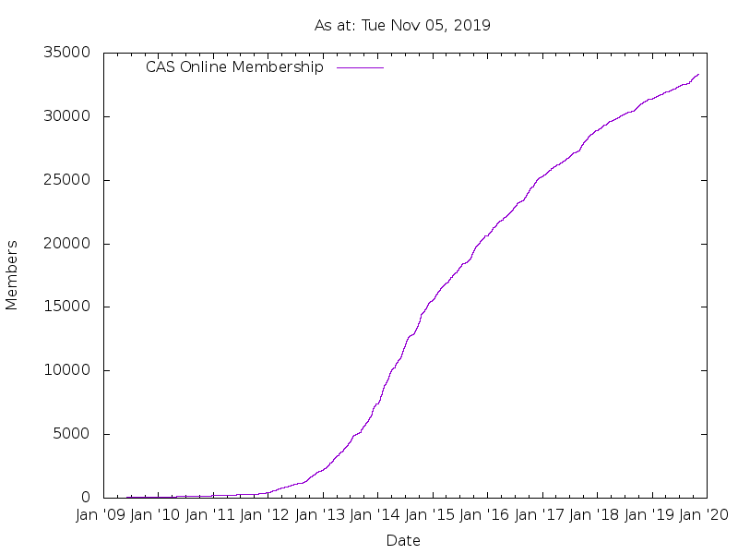
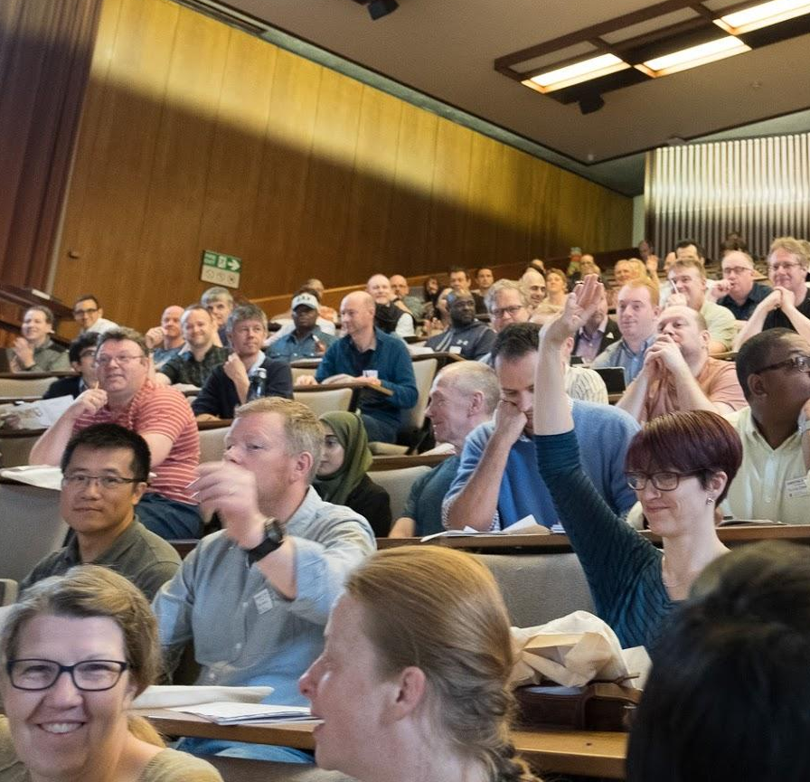
Computing At School

Slide 35
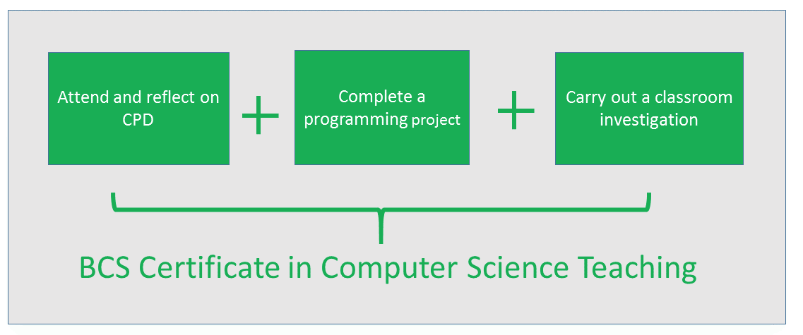

Slide 36
Teaching materials

Slide 37
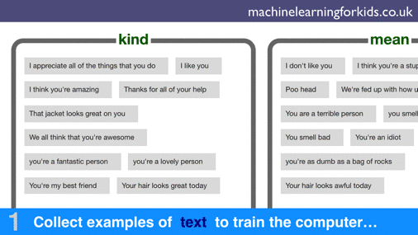
Machine learning 4 kids

Slide 38
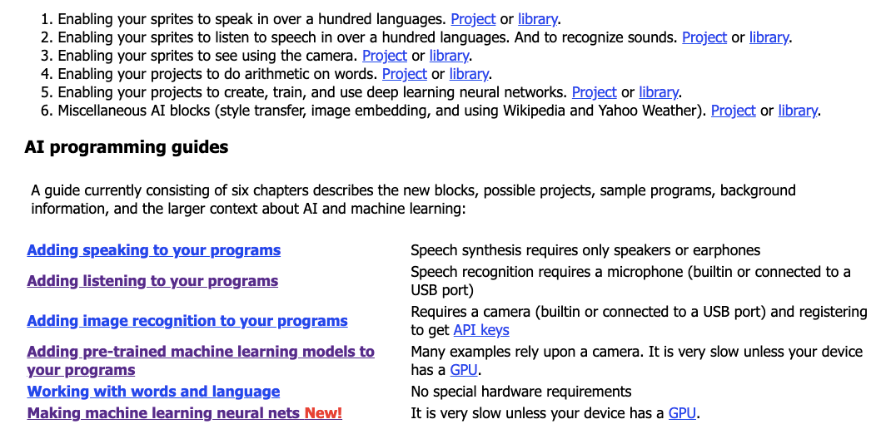
eCraft2Learn

Slide 39
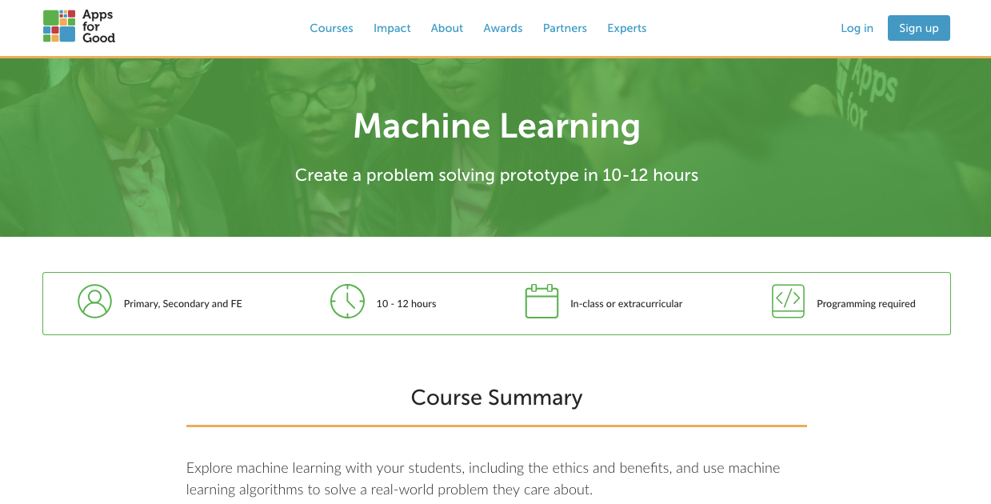

Slide 40
Incentives and drivers

Slide 41
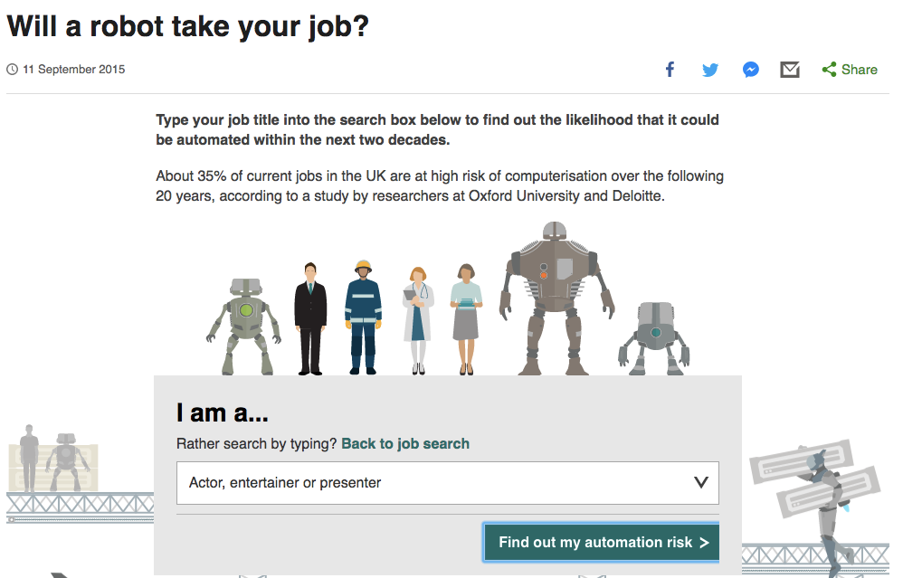
http://www.bbc.co.uk/news/technology-34066941

Slide 42
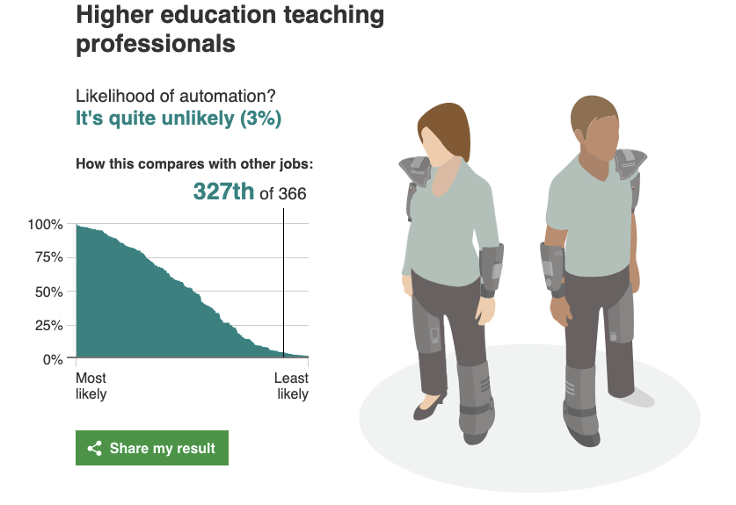

Slide 43


Slide 44
Discussion...
m.berry@roehampton.ac.uk
@mberry
milesberry.net
These slides: bit.ly/aaai19slides

